Slide 1
DISTRIBUTED SYSTEMS AND CLOUD COMPUTING
UNIT I
Distributed System Models & Enabling technology:
Scalable computing over the internet
Technologies for network based system,
System models for distributed & cloud,
Software environments for distributed & Cloud.
Introduction to Cloud Computing:
Cloud Computing in a Nutshell System
Roots of Cloud Computing,
Grid and Cloud,
Layers and Types of Clouds,
Desired Features of a Cloud,
Basic Principles of Cloud Computing,
Challenges and Risks,
Service Models.
SLA Management in the Cloud :
Types of SLA
Life Cycle of SLA
SLA management in the cloud

Slide 2
CHAPTER 1: Distributed System Models and Enabling Technologies
Scalable Computing over the Internet
1.1.1 The Age of Internet Computing
1.1.2 Scalable Computing Trends and New Paradigms
1.1.3 The Internet of Things and Cyber-Physical Systems

Slide 3
SCALABLE COMPUTING OVER THE INTERNET
Scalalibility: is the ability of a computer product (software or hardware) or an application to continue to function well (in spite of the changes in size or volume) in order to meet the user requirements.
Computer technology – evolved to a greater extent
Series of changes – both platform & environment
  OS platform
  Network connectivity
  Machine architecture
  Application workload
  To solve large computations:
    Earlier – Centralized Computer (single computer)
    Now – Parallel & Distributed Computing (multiple computers)
  Thus, Distributed Computing becomes data intensive and network centric.

Slide 4
THE AGE OF INTERNET COMPUTING
Billions of people are using Internet everyday.
As a result, super computers and centers – provide high performance computing services
High Performance Computing (HPC) - No longer optimal for measuring system performance.
Emergence of Cloud Computing -
  Demands for High Throughput Computing (HTC) systems
  Based on parallel and distributed technologies
Thus, the purpose is to advance network based computing, web services along with the emerging new technologies.

Slide 5
THE PLATFORM EVOLUTION
Computer technology has gone through five generations of development:
1950 – 1970 : Mainframes (IBM 360)
1960 – 1980 : Low-cost Mini Computers
1970 – 1990 : Widespread of Personal Computers
1980 – 2000 : Massive no. of Portable Computers
Since 1990 : Use of HPC & HTC systems (also known as computational grids)
HPC and HTC systems hidden in clusters, grids, or Internet clouds has increased rapidly.

Slide 6
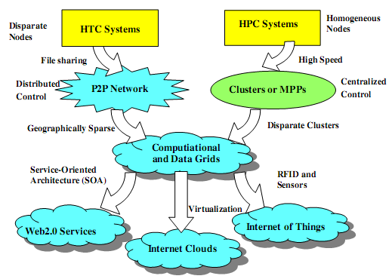
  Evolutionary trend toward parallel, distributed, and cloud computing with clusters, MPPs, P2P networks, grids, clouds, web services, and the Internet of Things.
HPC: supercomputers (massively parallel processors or MPPs) - replaced by clusters.
HTC: peer-to-peer (P2P) networks - distributed file sharing and content delivery applications.
** P2P, cloud computing, and web service platforms - more focused on HTC applications than on HPC applications.
** Clustering & P2P technologies - lead to the development of computational grids or data grids

Slide 7
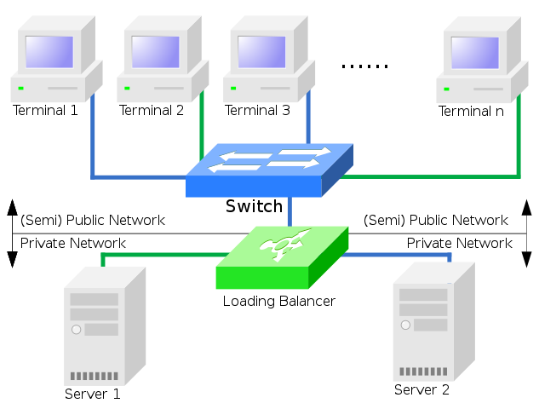
COMPUTER CLUSTERS
Computer cluster:
  set of computers that work together
  can be viewed as a single system.
Unlike grid computers, computer clusters have each node set to
  perform the same task, controlled and scheduled by software.
Components of a cluster
  connected to each other through fast local area networks.

Slide 8
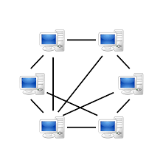
P2P NETWORKS
A peer to peer network
  a simple network of computers.
Here, each computer acts as
  a node for file sharing &
  also acts as a server.
No central server to the network.
Allows sharing of a huge amount of data.
Tasks are equally divided amongst the nodes.

Slide 9
HIGH PERFORMANCE COMPUTING (HPC)
HPC systems emphasize the raw speed performance.
Speed of HPC systems has increased:
  - Gflops (Giga floating-point operations per second) - 1990s to
  - Pflops (Peta floating-point operations per second) - 2010.
Driven mainly by the demands from scientific, engineering, and manufacturing communities.

Slide 10
HIGH THROUGHPUT COMPUTING (HTC)
Main application of HTC is:
  Internet searches & Web services
  by millions or more users simultaneously.
Performance goal - shifts to measure high throughput or the number of tasks completed per unit of time.
HTC - not only improve processing speed,
  also address the acute problems of cost, energy savings, security, and reliability at many computing centers.

Slide 11
THREE NEW COMPUTING PARADIGMS
Service Oriented Architecture:
In simpler terms, SOA is a software design where services are provided to other components by application components.
In SOA, a service is a self-contained unit of software designed to complete a specific task.
Service-oriented architecture allows various services to communicate using a loose coupling system to either pass data or coordinate an activity.

Slide 12
THREE NEW COMPUTING PARADIGMS (CONTD)
Internet Cloud:
Advances in virtualization - to see the growth of Internet clouds as a new computing paradigm.
Internet of Things:
Radio-frequency identification (RFID), Global Positioning System (GPS), and sensor technologies - triggered the development of the Internet of Things (IoT).
A networked connection of everyday objects including computers, sensors, humans, etc.
IoT is supported by Internet clouds to achieve ubiquitous computing with any object at any place and time.

Slide 13
COMPUTING PARADIGM DISTINCTIONS
Distributed computing - opposite of centralized computing
Parallel computing - overlaps with distributed computing to a great extent
Cloud computing - overlaps with distributed, centralized, and parallel computing
Centralized computing:
All computer resources are centralized in one physical system.
All resources (processors, memory, and storage) are fully shared and tightly coupled within one integrated OS.

Slide 14
Parallel computing:
All processors are either tightly coupled with centralized shared memory or loosely coupled with distributed memory.
Inter process communication is accomplished through shared memory or via message passing.
Distributed computing:
A field of computer science that studies distributed systems.
A distributed system consists of multiple autonomous computers, each having its own private memory, communicating through a computer network.
Information exchange in a distributed system is accomplished through message passing.

Slide 15
Cloud computing:
An Internet cloud of resources can be either a centralized or a distributed computing system.
The cloud applies parallel or distributed computing, or both.
Clouds can be built with physical or virtualized resources over large data centers that are centralized or distributed.
Concurrent computing or concurrent programming:
Union of parallel computing and distributing computing.
Ubiquitous computing:
Computing with pervasive devices at any place and time using wired or wireless communication.
Internet computing: is even broader and covers all computing paradigms over the Internet.

Slide 16
DISTRIBUTED SYSTEM FAMILIES
Technologies used for building P2P networks & networks of clusters
- have been consolidated into wide area computing infrastructures, - known as computational grids or data grids
Internet clouds:
- result of moving desktop computing to service-oriented computing
- using server clusters & huge databases at data centers.
In the future, both HPC and HTC systems
- will demand multicore or many-core processors
- handle large numbers of computing threads per core.
Both HPC and HTC systems emphasize:
- parallelism & distributed computing.
Future HPC & HTC systems must be able to satisfy this huge demand
- in terms of throughput, efficiency, scalability, and reliability.
The system efficiency is decided by speed, programming, and energy factors (i.e., throughput per watt of energy consumed).

Slide 17
Meeting these goals requires to yield the following design objectives:
Efficiency – measures the utilization rate of resources, by exploiting massive parallelism in HPC.
For HTC, efficiency is more closely related to job throughput, data access, storage, and power efficiency.
Dependability - measures the reliability and self-management from the chip to the system and application levels.
- purpose is to provide high-throughput service with Quality of Service (QoS) assurance, even under failure conditions.
Adaptation - measures the ability to support billions of job requests over massive data sets and virtualized cloud resources under various workload and service models.
Flexibility - measures the ability of distributed systems to run well in both HPC (science and engineering) and HTC (business) applications.

Slide 18
SCALABLE COMPUTING TRENDS AND NEW PARADIGMS
DEGREES OF PARALLELISM
50 years ago - bit-level parallelism (BLP)
From past 30 years - instruction-level parallelism (ILP)
Data-level parallelism (DLP) - through SIMD (single instruction, multiple data)
Task-level parallelism (TLP) - since the introduction of multicore processors

Slide 19
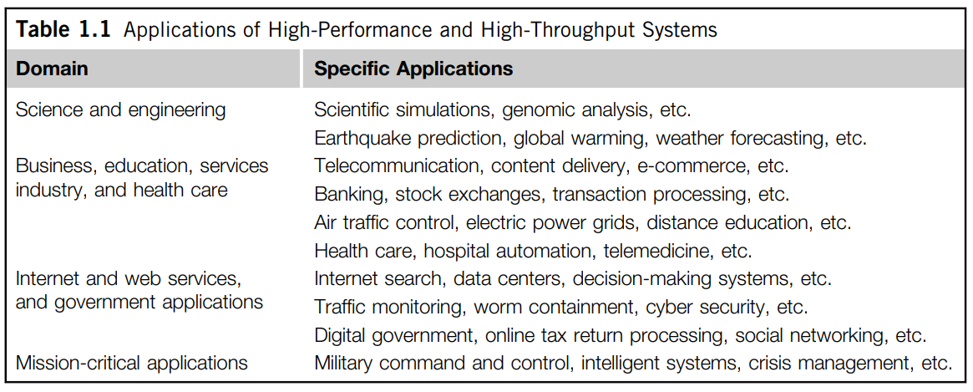
INNOVATIVE APPLICATIONS
Table 1.1 highlights few key applications that have driven the development of parallel and distributed systems:

Slide 20
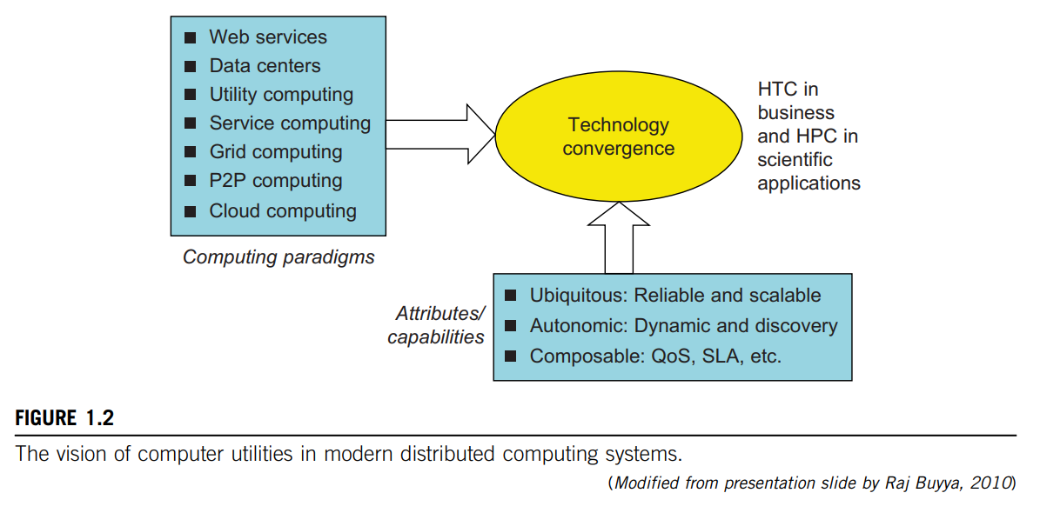
THE TREND TOWARD UTILITY COMPUTING
Utility computing focuses on a business model in which customers receive computing resources from a paid service provider.
All grid/cloud platforms are regarded as utility service providers.
However, cloud computing offers a broader concept than utility computing.

Slide 21
THE HYPE CYCLE OF NEW TECHNOLOGIES
Any new and emerging computing and information technology may go through a hype cycle, as illustrated in Figure 1.3. This cycle shows the expectations for the technology at five different stages:
hollow circles - technologies will reach mainstream adoption in two years.
gray circles - technologies will reach mainstream adoption in two to five years.
solid circles - require five to 10 years to reach mainstream adoption,
triangles - require more than 10 years.
crossed circles - technologies that will become obsolete before they reach the plateau.

Slide 22
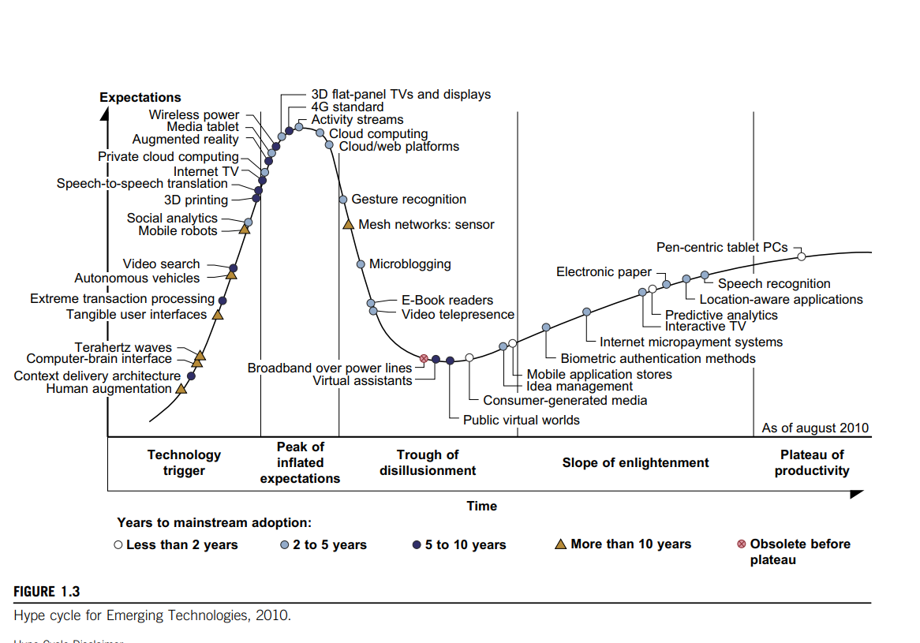

Slide 23
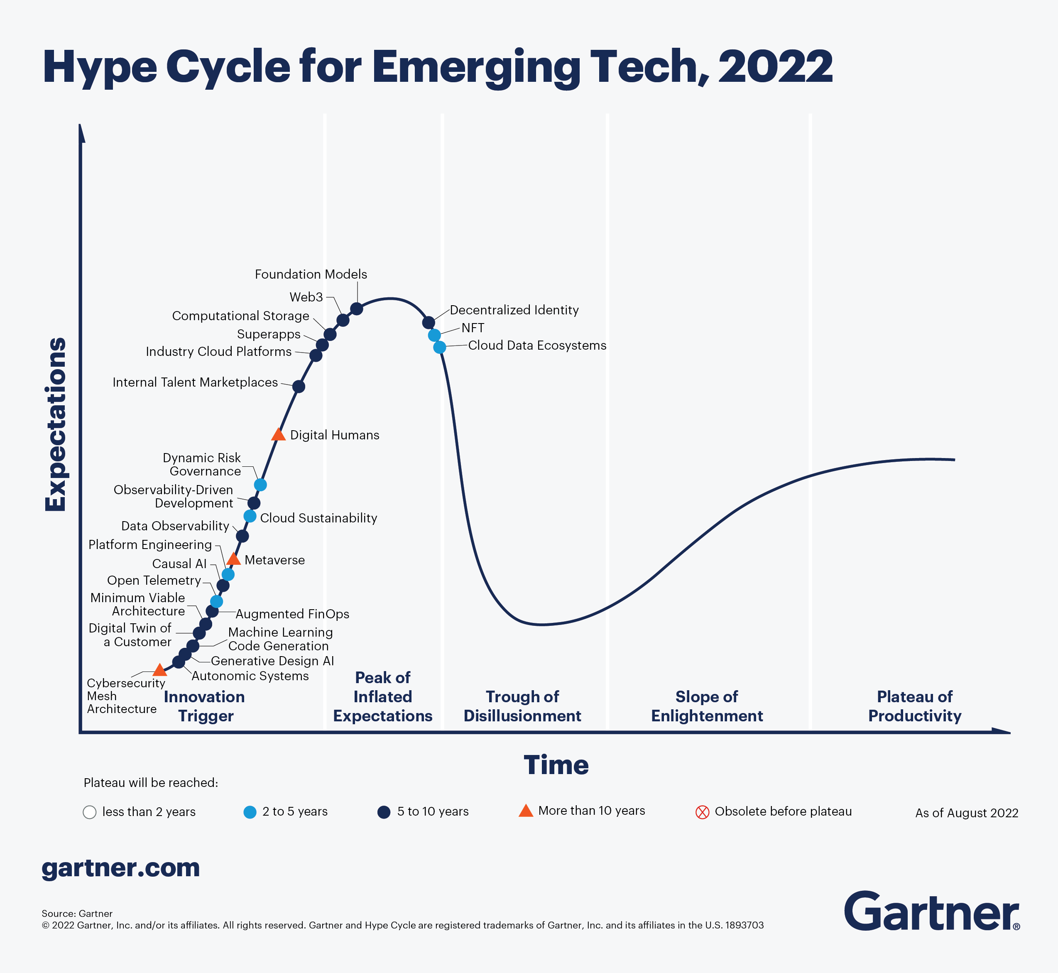

Slide 24
THE INTERNET OF THINGS
THE INTERNET OF THINGS AND CYBER-PHYSICAL SYSTEMS
Traditional Internet - connects machines to machines or web pages to web pages.
IoT - refers to the networked interconnection of everyday objects, tools, devices, or computers.
- a wireless network of sensors that interconnect all things in our daily life.
- idea is to tag every object using RFID or a related sensor or electronic technology such as GPS.
In the IoT era, all objects and devices are instrumented, interconnected, and interacted with each other intelligently.
This communication can be made between people and things or among the things themselves.

Slide 25
CYBER-PHYSICAL SYSTEMS
Cyber-physical system (CPS) - result of interaction between computational processes and the physical world.
A CPS integrates “cyber” (heterogeneous, asynchronous) with “physical” (concurrent and information-dense) objects.
IoT emphasizes various networking connections among physical objects, while the CPS emphasizes exploration of virtual reality (VR) applications in the physical world.

